Slide 1
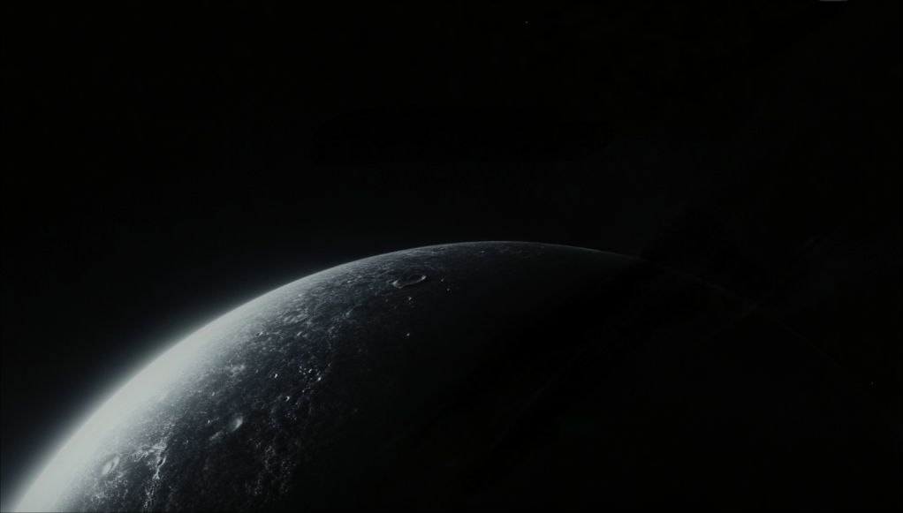
Create with Generative AI
Sean Wong
2025/01/01

Slide 2

CONTENTS
01
AI Creates
02
Inside the Models
03
Text & Code Magic
04
Visual & Audio Art
05
Moving Pictures
06
Hands-On Creation

Slide 3
CONTENTS
01
Ethics & Outlook
02
Wrap-Up Action

Slide 4

01
AI Creates

Slide 5

Definition of Generative AI
Generative AI is a type of artificial intelligence that can create new content, such as text, images, music, and more, based on patterns it has learned from existing data. Unlike traditional AI, it doesn't just analyze or predict; it generates something entirely new.
Impact on Creativity
Generative AI Revolution
This technology empowers anyone to become a creator by turning simple prompts into original works in seconds. It redefines how we think about creativity, authorship, and innovation across various industries, making the creative process more accessible and scalable.
Diverse Applications
Generative AI is being used in fields like writing, design, music, and video production. It can write essays, generate artwork, compose music, and even create animations, offering new possibilities for content creation and personalization.

Slide 6
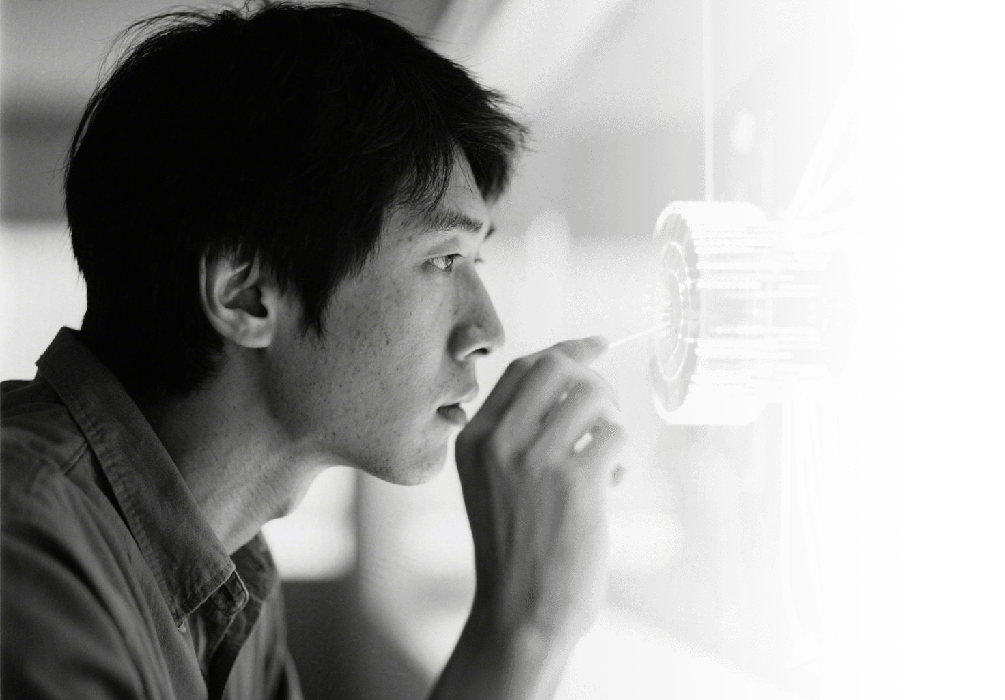
Traditional versus Generative AI
Traditional AI Focus
Traditional AI focuses on classifying or predicting data based on existing patterns. It is used for tasks like image recognition, fraud detection, and weather forecasting, where the goal is to analyze and make predictions about existing data.
Generative AI Innovation
Generative AI, on the other hand, creates new content from scratch. It uses models like GANs and Transformers to generate text, images, music, and more. This ability to generate new data sets it apart from traditional AI and opens up new possibilities for creative applications.

Slide 7
02
Inside the Models

Slide 8
Neural Creativity Engines
Scalable Creativity
Training Process
Deep Learning Architectures
Iterative Improvement
Generative models enable scalable creativity by allowing users to generate multiple variations of content quickly. This reduces the time and effort required for traditional creative processes, making it easier to explore different ideas and concepts.
During training, these models adjust billions of parameters to minimize reconstruction error. They learn to generate content by sampling from the learned distributions, allowing them to produce entirely new artifacts based on input prompts.
Generative AI relies on deep learning models like GANs and Transformers. These models learn statistical patterns from large datasets and use this knowledge to create new, coherent outputs that mimic human-created content.
In some systems, like GANs, two models work together: one generates content, and the other critiques it. This feedback loop helps the generator improve over time, resulting in higher-quality outputs.

Slide 9
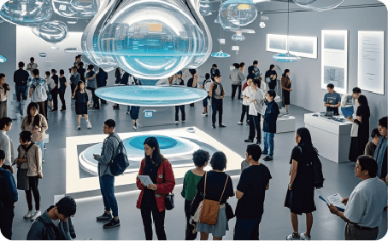
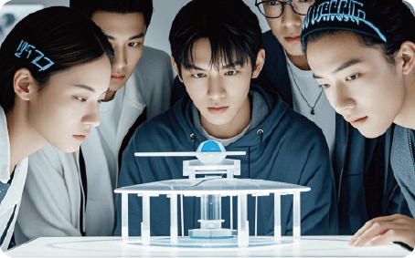
Training Data Foundations
Importance of Training Data
The quality and diversity of training data are crucial for generative models. High-quality, diverse datasets help models learn a wide range of patterns and styles, resulting in more versatile and unbiased generated content. Poor data can lead to biased or low-quality outputs.

Slide 10
03
Text & Code Magic

Slide 11
GPT Writes Anything
Iterative Refinement
Users can refine the generated text by providing additional context or constraints. This iterative process helps achieve the desired tone, length, and format, making the output suitable for various applications like content creation and customer support.
Language Models
Large language models like GPT-3 and ChatGPT can generate coherent text based on natural-language prompts. They produce essays, stories, emails, and more in seconds, making writing tasks faster and more efficient.

Slide 12
AI Pair-Programming
02
01
03
Accelerated Prototyping
AI accelerates prototyping by reducing the time spent on repetitive coding tasks. Developers can focus on creative problem-solving and exploring new ideas, while the AI handles boilerplate code and syntax.
Code Generation
Exploring New Libraries
AI models like Codex can translate natural-language prompts into functional code. They help developers write code faster by providing suggestions, completing algorithms, and suggesting bug fixes.
AI can help developers explore unfamiliar libraries by generating code snippets and explaining their usage. This makes it easier to learn new tools and technologies, enhancing overall productivity.

Slide 13
04
Visual & Audio Art

Slide 14

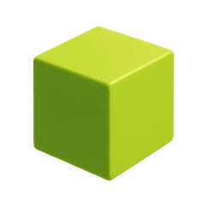
DALL-E Paints Ideas
Text-to-Image Models
Models like DALL-E and Midjourney can generate high-resolution images from textual descriptions. Users provide prompts, and the AI creates artwork, product mockups, or marketing visuals, making design accessible to non-experts.
Iterative Styling
Users can iterate on prompts, style modifiers, and seed values to steer the aesthetics of generated images. This allows for rapid visualization of concepts and customization of visual outputs.

Slide 15

AI Composes Music
Music Generation Platforms
Platforms like AIVA and Jukedeck generate original music tracks based on specified genres or moods. Users can customize tempo, instrumentation, and length to create royalty-free music for various purposes.
Rapid Composition
Human Editorial Control
AI reduces the time required for music composition, allowing creators to produce original pieces quickly. This is particularly useful for film scores, game soundtracks, and other applications where speed is essential.
Despite AI-generated music, human creators maintain control over the final output. They can refine and edit the generated tracks to ensure they meet specific creative and technical requirements.

Slide 16
05
Moving Pictures

Slide 17
Synthetic Video Generation
Video Generation Tools
Emerging tools like Runway ML and Pika Labs can generate short video clips, animations, and deepfake-style face replacements from text prompts or still images. These tools accelerate video creation and offer new possibilities for filmmakers and content creators.

Slide 18
3D Worlds from Words
01
02
03
04
3D Generation Models
Interactive Iteration
Efficient Prototyping
Future Creative Workflows
New models like diffusion and NeRF can generate 3D meshes, textures, and virtual environments directly from textual descriptions. These models enable rapid prototyping of immersive spaces for gaming, architecture, and the metaverse.
Users can interactively iterate on 3D designs by modifying prompts and parameters. This allows for quick exploration of different concepts and layouts before committing to high-fidelity modeling or physical production.
Generative AI reduces the time and resources required for 3D prototyping. Designers can quickly visualize and refine virtual environments, speeding up the creative process and enabling faster iteration.
Expect real-time multimodal models that accept mixed text, sketch, and voice inputs to produce cohesive cross-media campaigns. Democratized creativity will flood markets, elevating human value toward curation, storytelling, and emotional intelligence.

Slide 19
06
Hands-On Creation

Slide 20
Prompt Engineering Basics
Effective Prompts
Effective prompts combine clear subject, style cues, and constraints. Iterative refinement, keyword weighting, and negative prompts help steer outputs toward desired results while avoiding unwanted elements.
01
Language of Communication
02
Mastering the language of communication with generative AI unlocks precise creative control and minimizes random trial-and-error across text, image, and audio generators.
Iterative Refinement
Users can refine generated content by providing additional context or constraints. This iterative process helps achieve the desired tone, length, and format, making the output suitable for various applications.
03

Slide 21

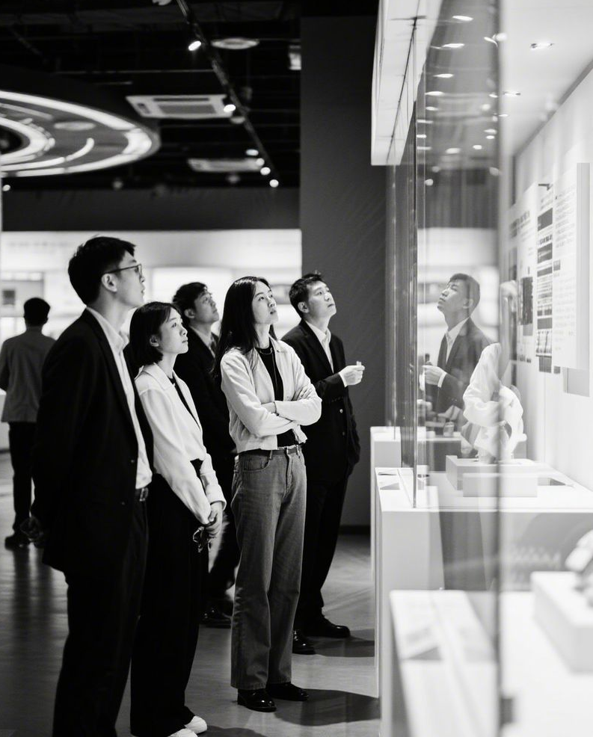

Live Text & Image Lab
Text and Image Generation
Rapid Iteration
Participants use ChatGPT and DALL-E to generate a short story and matching illustration. They iterate on prompts to unify visual and narrative tone, demonstrating real-time co-creation and building confidence in tool interaction.
This exercise shows how minor prompt tweaks produce dramatically different artistic outcomes. Participants experience the power of generative AI in creating cohesive, creative content quickly.

Slide 22
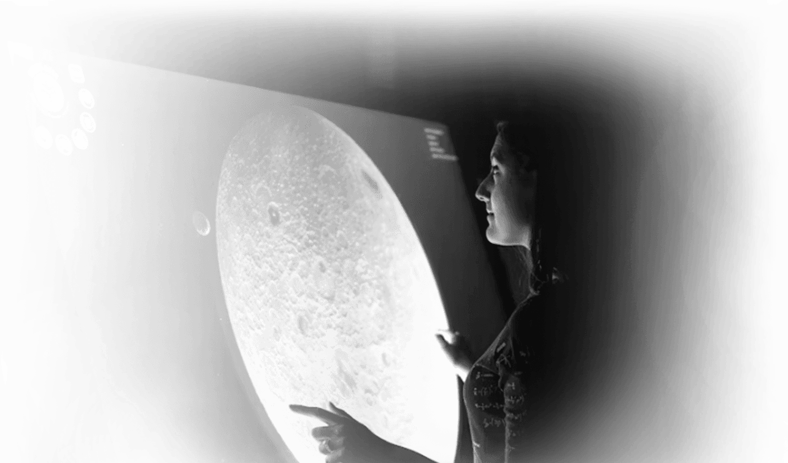
Music & Video Mini-Project
Multimedia Creation
Groups use AIVA to compose a jingle and Runway ML to generate a lyric video. They experience an end-to-end creative pipeline that previously required specialized software, musicians, and editors, now achievable in under an hour with generative AI.

Slide 23
07
Ethics & Outlook

Slide 24
Bias Truth and Ownership
Bias in Training Data
Training data can embed societal biases, producing skewed text, stereotyped images, or plagiarized snippets. Creators must audit outputs to ensure fairness and avoid perpetuating harmful biases.
Ethical Content Creation
Responsible Use
Clear attribution and transparent workflows maintain audience trust and comply with emerging legal standards for generative content. Creators should disclose AI assistance and respect copyright boundaries.
Ethical considerations are crucial in the use of generative AI. Creators must ensure that generated content is used responsibly and does not harm individuals or society.

Slide 25
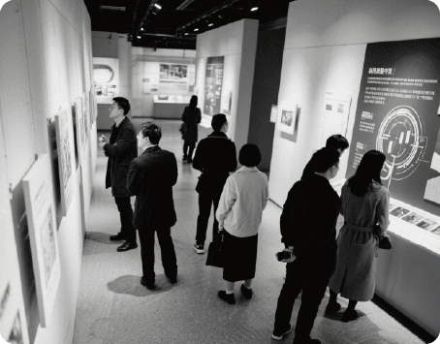
Deepfake Misinformation Risk
Synthetic Media Risks
Synthetic media can fabricate realistic speeches or events, threatening public discourse and personal reputations. Implementing watermarking and verification platforms helps mitigate harm.
Educational Responsibility
Educators and media professionals have a responsibility to teach critical consumption and ethical production of AI-generated visuals and audio. This helps build a more informed and responsible user base.

Slide 26
Future Creative Workflows
Real-Time Multimodal Models
Ethical Considerations
Expect real-time multimodal models that accept mixed text, sketch, and voice inputs to produce cohesive cross-media campaigns. These models will revolutionize creative workflows.
As generative tools evolve, ethical considerations become even more important. Creators must balance experimentation with critical evaluation to ensure responsible use.
Democratized Creativity
Continuous Learning
Generative AI will democratize creativity, making it accessible to a broader audience. This will lead to an explosion of creative content, elevating the value of human curation and storytelling.
Lifelong learning in prompt craft and ethical oversight becomes essential for next-generation professionals. Staying informed about new developments and best practices is crucial.

Slide 27
08
Wrap-Up Action

Slide 28
Your First AI Portfolio Piece
Commit to Creating
Commit to publishing one AI-assisted creation within 48 hours. This could be a blog post illustrated with DALL-E art or a lo-fi track composed in AIVA. Document your prompt iterations and ethical checks.
Share and Gather Feedback
Share your creation publicly and gather feedback. This will help you improve and establish your personal generative-AI practice. Continuous iteration is key to mastering these tools.

Slide 29
Keep Exploring Responsibly
“
Responsible Exploration
Stay curious about new model releases and participate in open-source communities. Advocate for transparent, fair AI development. Balance experimentation with critical evaluation to ensure ethical use of generative AI.
“

Slide 30

THANK
YOU
Sean Wong
2025/01/01

